Slide 1
Finding Bad Guys with 35 Million Flows, 2 Analysts, 5 minutes and 0 dollars
Bsides Knoxville 2015
Russell Butturini (@tcstoolhax0r)
tcstool@gmail.com

Slide 2
My Least Favorite Slide
I’m the senior enterprise security architect at one of Nashville/Franklin’s plethora of healthcare companies.
-If you really want to know which one, I’m sure you’ll find out…
I do mostly red team stuff, so this talk is going to be incredibly uncomfortable for me…
I write a lot of tools (NASNum, NoSQLMap, Skiddiemonkeys) that hopefully make people’s lives easier.
I’m a die hard Manchester City fan, which is a tough thing to admit this season.

Slide 3

Disclaimer #1-I am not Tom Petty

Slide 4

Disclaimer #2-I am not an expert on packets, Netflow, or forensics
Notes:
I failed the CCIE Security lab not once, twice but THREE times (and then gave up).
I know a lot about firewalls and routing, but deep dives really bore me.

Slide 5

History of Security Monitoring Part I

Slide 6
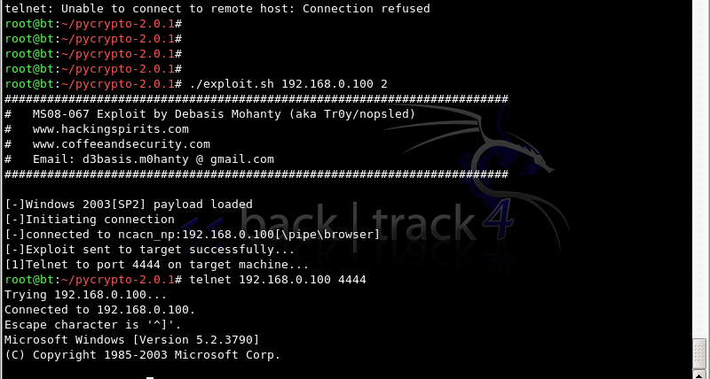
Attackers used to do this…

Slide 7
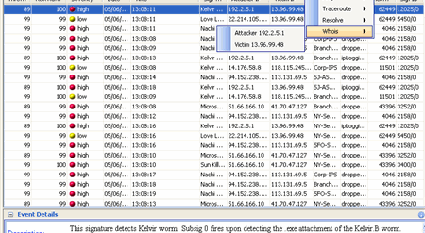
So we did this….

Slide 8
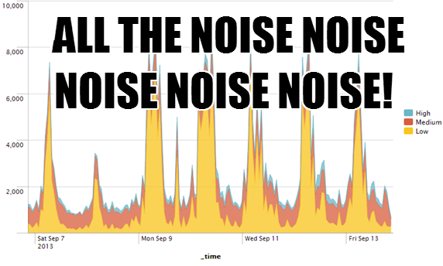
But when we looked at it, we saw this…

Slide 9
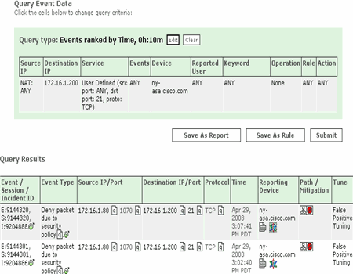
So we bought this…

Slide 10
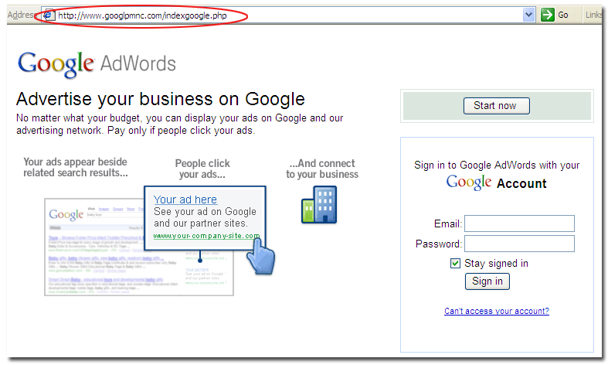
Then attackers started doing this…

Slide 11

Let me tell y’all a story…

Slide 12
…about a messy network
~3,500 users, depending on who you ask…
350 externally facing resources (mostly web apps) that are variants of 35-40 core code bases, along with SFTP, email, SSH, and other “stuff” in the data center.
Two 400 meg outbound Internet circuits.
14 remote offices, including two located outside the US.
A massive work from home and teleworker/road warrior user base.
Infrastructure as a service on Microsoft Azure and Amazon AWS.

Slide 13

Where we were
Really good at event logging.
Pretty good at alerting.
Not so good at reacting.
Notes:
-We went through four SIEM products in 5 years before we found a combination of tools we liked.
-The alerts were largely intelligible and tuned to only give us the real stuff we cared about.
-We had limited resources (1 guy for a while and then 2) to even look at the stuff and figure out what’s going on.
-Outsourced IT providers where you had to go through a guy to the guy to the guy to the guy who might be able to help you.

Slide 14

I got the job of fixing it…

Slide 15
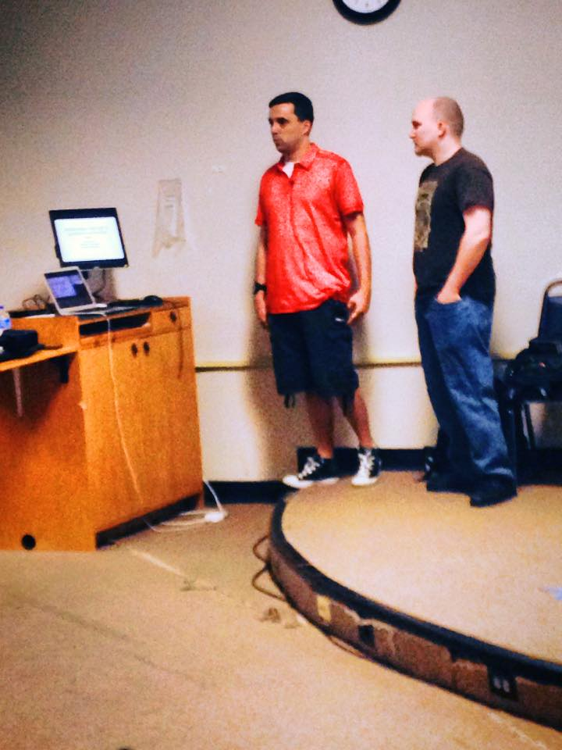
With this many people…

Slide 16

And this much budget…

Slide 17
Getting Started
Stop correlating-Events A+B+C+D=Correlated bad thing, when A alone was bad enough and we had to wait for the other three things then pull it all back apart.
Assume all events/connections are potentially bad, instead of static rule based analysis.
Find the data points we really care about.

Slide 18
Getting Started
Two areas chosen for monitoring:
-User behavior (a whole separate talk in and of itself)
-Perimeter Netflow
Do we still need to archive everything else? YES! But we only look at it when we’re pivoting off a higher level event instead of trying to use all events as a “top level” investigative source.
Notes:
Why the perimeter? I had to start somewhere, and I had limited resources.
I had an advantage. All the remote sites backhauled their Internet access through the data center’s two Internet circuits, and all remote workers use “always on” full tunnel VPNs from their work assets.
Theory: If it stays in our data center, I have pretty good monitoring and containment methods. If it leaves, I’m screwed.
I had a huge advantage since all my remote sites backhauled their Internet through the main data center.

Slide 19
Netflow Primer
Cisco proprietary name
-“Often imitated, never duplicated.”
IP traffic records that can be exported from network hardware to other places for analysis.
Comes in two versions v5 and v9
-I chose v5 because the records are smaller had everything I need.
Can be collected in various forms from routers, switches, firewalls, load balancers, etc.

Slide 20
Sample Netflowv5 Record
Bytes | Contents | Description
0-3 | srcaddr | Source IP address
4-7 | dstaddr | Destination IP address
8-11 | nexthop | IP address of next hop router
12-13 | input | SNMP index of input interface
14-15 | output | SNMP index of output interface
16-19 | dPkts | Packets in the flow
20-23 | dOctets | Total number of Layer 3 bytes in the packets of the flow
24-27 | first | SysUptime at start of flow
28-31 | last | SysUptime at the time the last packet of the flow was received
32-33 | srcport | TCP/UDP source port number or equivalent
34-35 | dstport | TCP/UDP destination port number or equivalent
36 | pad1 | Unused (zero) bytes
37 | tcp_flags | Cumulative OR of TCP flags
38 | prot | IP protocol type (for example, TCP = 6; UDP = 17)
39 | tos | IP type of service (ToS)
40-41 | src_as | Autonomous system number of the source, either origin or peer
42-43 | dst_as | Autonomous system number of the destination, either origin or peer
44 | src_mask | Source address prefix mask bits
45 | dst_mask | Destination address prefix mask bits
46-47 | pad2 | Unused (zero) bytes
Notes:
TCP Flags are CUMULATIVE in hex. So you have to reverse flow records to see what was in the session.

Slide 21

Then This man gave a webinar…

Slide 22
SANS FOR572 VM
FREE virtual machine with everything you need to start collecting and analyzing Netflow already set up!
http://sourceforge.net/p/sansfor572logstash/wiki/Home/
Based on the ELK (Elasticsearch, Logstash, Kibana) stack.
Notes:
We’ll talk about what each piece of ELK is.

Slide 23

But I only had Hyper-V
Notes:
When I tried to convert it….

Slide 24
Hope is not lost!
There are lots of great guides on setting up ELK to collect Netflow!
One of the best is provided by Cisco:
http://blogs.cisco.com/security/step-by-step-setup-of-elk-for-netflow-analytics
So I can build this thing from scratch, no problem!

Slide 25
Logstash
http://logstash.net/
Can collect, parse, rewrite and store logs in many different formats.
Part of the Elasticsearch family of products.
Open source.
Built in Netflow collector.
Written in Java.

Slide 26

So I sent Logstash our production Netflow…
Notes:
It sucked up 17.1 gigs of virtual RAM immediately and looked like this.

Slide 27
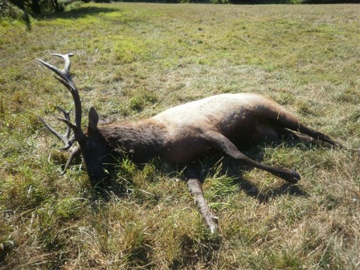
Now I have a dead ELK

Slide 28
Fluentd saves the day!
http://www.fluentd.org/guides
Written in a combination of C and Ruby
Designed for minimal resource consumption
-A vanilla instance will run on 30-40 MB of memory and can process 13,000 EPS.
Tries to structure data as JSON as much as possible
Plugin based architecture (including plugins for Netflow)
Support HA and failover
“Unified logging layer”
Notes:
Like Logstash will do geotagging against Maxmind.

Slide 29
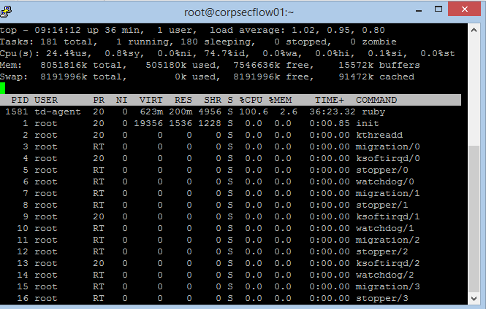
Fluentd saves the day!

Slide 30
Now I have to store it…
Elasticsearch: https://www.elastic.co/
Scales horizontally
-Lots of little machines are OK instead more expensive big hardware
Native JSON indexing
Real-Time Data availability
Notes:
All data is IMMEDIATELY made available for search and analytics

Slide 31
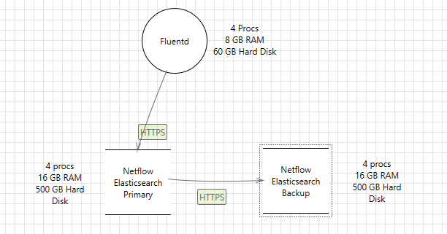
Architecture at this point

Slide 32
Now I have to look at it…
Geotagging!
-http://dev.maxmind.com/geoip/legacy/geolite/
-Free databases for both IP addresses and autonomous systems
Kibana: A web frontend to analyze data in Elasticsearch
-https://www.elastic.co/products/kibana
-Built in query languages to drill down on Elasticsearch data as well as a clickable interface.
I use Nginx as the web server for better real time refreshes and also to add a layer of security to keep people from messing with my dashboards.
Notes:
Fluentd can add geotag information into the JSON before it goes to Elasticsearch

Slide 33
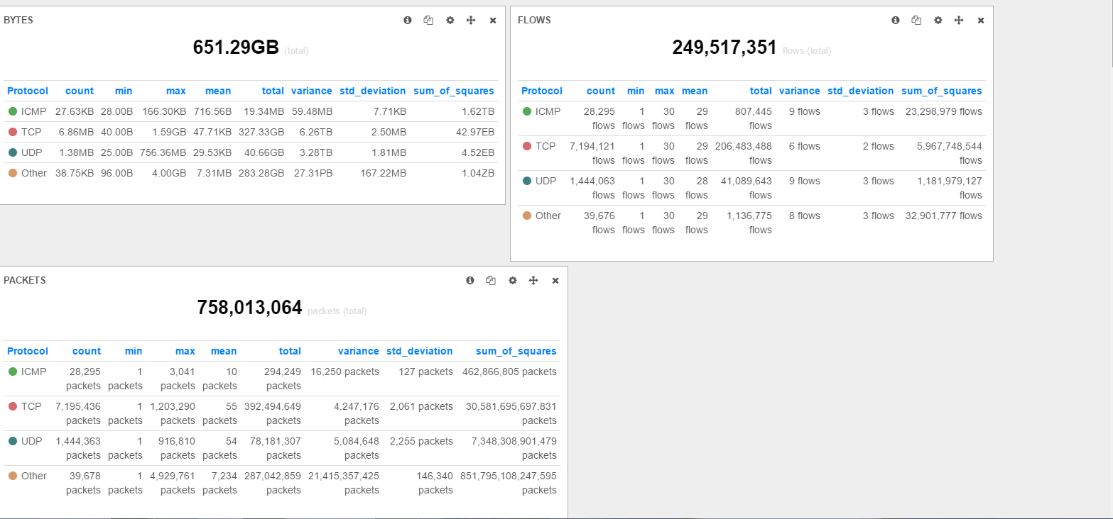
Kibana Dashboards

Slide 34
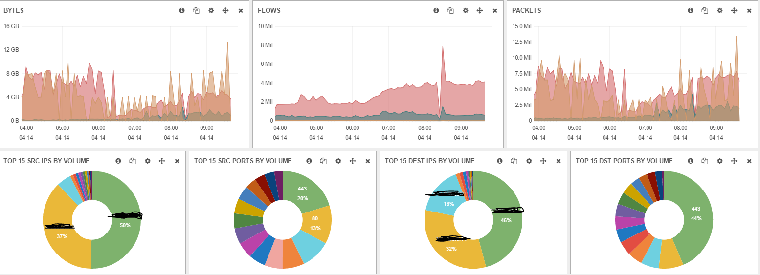
Kibana Dashboards

Slide 35
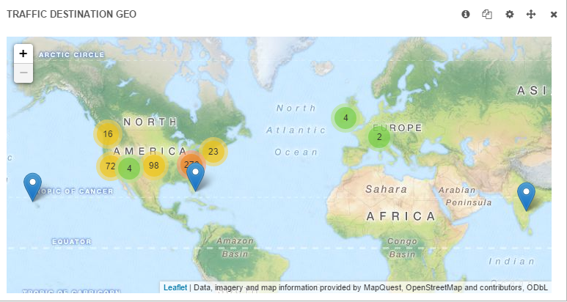
Kibana Dashboards

Slide 36
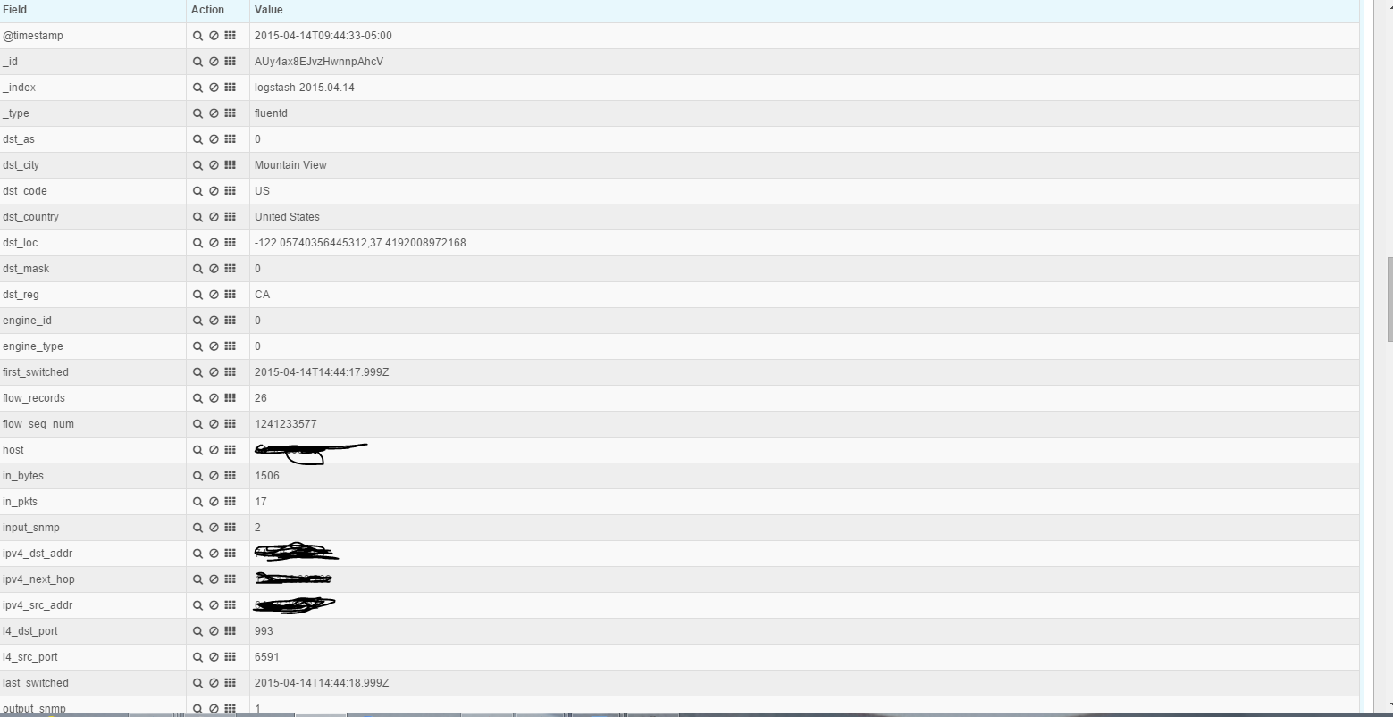
Kibana Document Analysis

Slide 37

Kibana Queries

Slide 38
Kibana Queries

Slide 39
Now I have to maintain it…
Elasticsearch does a pretty good job keeping itself healthy.
curl -XGET http://localhost:9200/_cluster/health?pretty=true
-Shows you the health of the cluster if using multiple Elasticsearch nodes.
curl -XGET http://localhost:9200/_cat/indices?v
-Shows you all the indices on the server.
Elasticsearch Curator: https://github.com/elastic/curator
-Easily manage and maintain your Elasticsearch data.
-I use this in a cron job to “close” indices nightly and open them as I need them.

Slide 40
Now I have to Impress the Executives…
Threat intelligence is trendy, and now I have a big repo of all my IP traffic.
So I made some scripts:
-feedpull.py Grabs threat intelligence feeds nightly.
-threattel.py Correlates threat intelligence feeds against the Elasticsearch database and generates emailed reports.
Thanks to syphon1c and Threatelligence for the inspiration!

Slide 41
Thanks for Coming!
THANK YOU THANK YOU THANK YOU to Phil Hagen for his work on the SANS FOR572 VM and making it freely available.
Questions/comments/Cuss words: @tcstoolhax0r
These slides and my Kibana dashboard schema are here: https://github.com/tcstool/netflow

